Slide 1
Data Analysis and Visualisation
Penalised Linear Regression Modelling

Slide 2
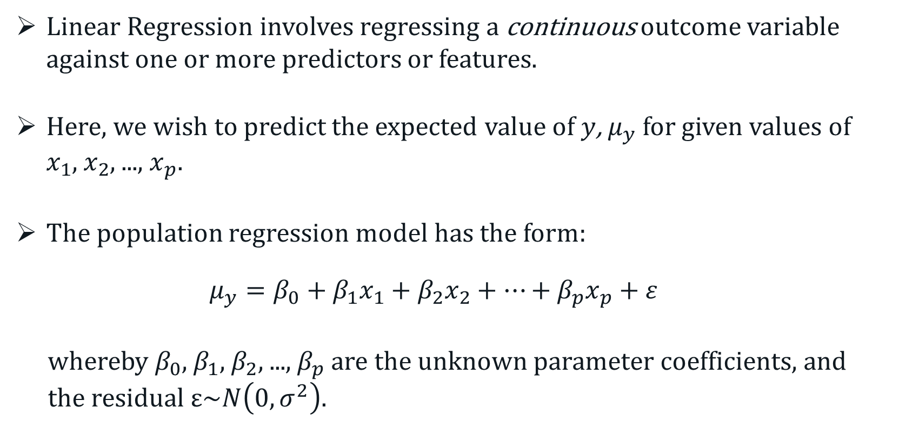
Linear Regression
Linear Regression involves regressing a continuous outcome variable against one or more predictors or features.
Here, we wish to predict the expected value of $y$, $μ_{y}$ for given values of $x_{1}$, $x_{2}$, ..., $x_{p}$.
The population regression model has the form:
$$μ_{y}=β_{0}+β_{1}x_{1}+β_{2}x_{2}+⋯+β_{p}x_{p}+ε$$
whereby $β_{0}$, $β_{1}$, $β_{2}$, ..., $β_{p}$are the unknown parameter coefficients, and the residual$ε\sim N\left(0,σ^{2}\right).$
Notes:
Cluster analysis is an “unsupervised” technique and makes no assumptions regarding the number of groups or the group structure.

Slide 3
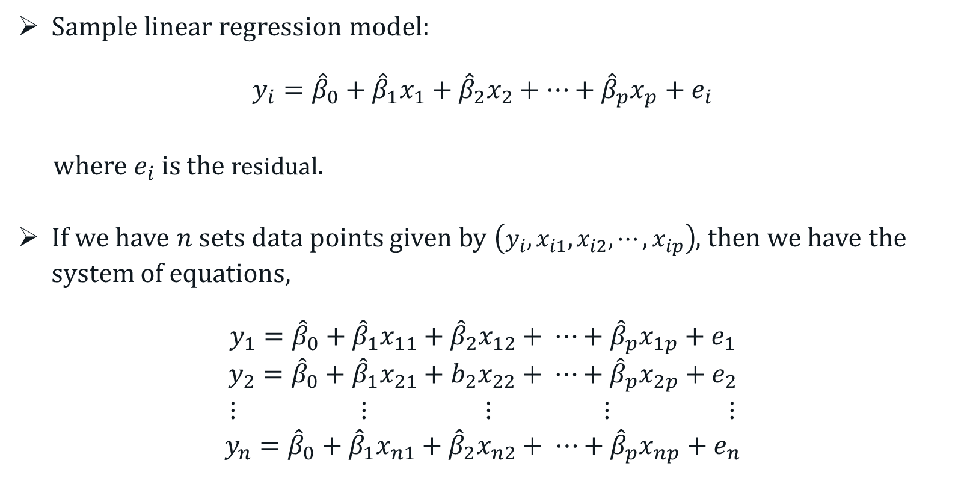
Linear Regression
Sample linear regression model:
$$y_{i}={\hat{β}}_{0}+{\hat{β}}_{1}x_{1}+{\hat{β}}_{2}x_{2}+⋯+{\hat{β}}_{p}x_{p}+e_{i}$$
where $e_{i}$is the residual.
If we have $n$ sets data points given by $\left(y_{i},x_{i1},x_{i2},⋯,x_{ip}\right)$, then we have the system of equations,
$$y_{1}={\hat{β}}_{0}+{\hat{β}}_{1}x_{11}+{\hat{β}}_{2}x_{12}+ ⋯+{\hat{β}}_{p}x_{1p}+e_{1}$$
$$y_{2}={\hat{β}}_{0}+{\hat{β}}_{1}x_{21}+b_{2}x_{22}+ ⋯+{\hat{β}}_{p}x_{2p}+e_{2}$$
$$⋮ ⋮ ⋮ ⋮ ⋮$$
$$y_{n}={\hat{β}}_{0}+{\hat{β}}_{1}x_{n1}+{\hat{β}}_{2}x_{n2}+ ⋯+{\hat{β}}_{p}x_{np}+e_{n}$$
Notes:
Cluster analysis is an “unsupervised” technique and makes no assumptions regarding the number of groups or the group structure.

Slide 4
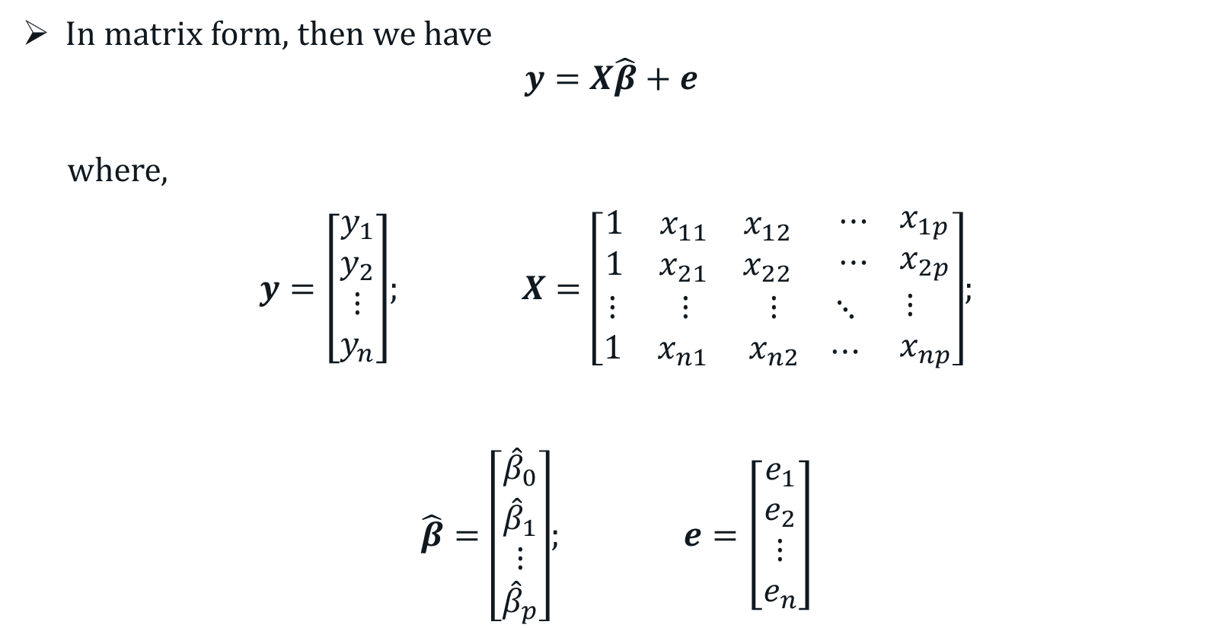
Linear Regression
In matrix form, then we have
$$y=X\hat{β}+e$$
where,
$y=\left[\begin{aligned}\begin{matrix}y_{1} \\ y_{2}\end{matrix} \\ ⋮ \\ y_{n}\end{aligned}\right]$; $X=\left[\begin{aligned}\begin{matrix}1 & x_{11} & x_{12} \\ 1 & x_{21} & x_{22}\end{matrix} \begin{matrix}⋯ \\ ⋯ \end{matrix}\begin{matrix}{ x}_{1p} \\ { x}_{2p}\end{matrix} \\ \begin{matrix}⋮ & ⋮ & ⋮ \\ 1 & x_{n1 } & x_{n2}\end{matrix} \begin{matrix}⋱ \\ ⋯ \end{matrix}\begin{matrix}⋮ \\ x_{np}\end{matrix}\end{aligned}\right]$;
$\hat{β}=\left[\begin{aligned}\begin{matrix}{\hat{β}}_{0} \\ {\hat{β}}_{1}\end{matrix} \\ ⋮ \\ {\hat{β}}_{p}\end{aligned}\right]$; $e=\left[\begin{aligned}\begin{matrix}e_{1} \\ e_{2}\end{matrix} \\ ⋮ \\ e_{n}\end{aligned}\right]$
Notes:
Cluster analysis is an “unsupervised” technique and makes no assumptions regarding the number of groups or the group structure.

Slide 5
Linear Regression
Example:
Suppose that we wish to study the relationship among the cardiovascular risk factors. The variables are:
y = oxygen consumption
x₁ = systolic blood pressure (mm Hg)
x₂ = total cholesterol (mg/dL)
x₃ = HDL cholesterol (mg/dL)
x₄ = triglycerides (mg/dL)
The subjects of this investigation are 20 males engaged in sedentary occupations.
Notes:
Cluster analysis is an “unsupervised” technique and makes no assumptions regarding the number of groups or the group structure.

Slide 6
Linear Regression
Example: Data
Subject | y | x₁ | x₂ | x₃ | x₄
1 | 32 | 133 | 211 | 42 | 156
2 | 46 | 131 | 217 | 46 | 239
3 | 40 | 119 | 162 | 50 | 163
4 | 24 | 120 | 233 | 44 | 153
5 | 42 | 134 | 184 | 61 | 99
6 | 22 | 152 | 288 | 27 | 238
7 | 23 | 136 | 213 | 31 | 113
8 | 24 | 123 | 180 | 24 | 134
9 | 23 | 110 | 208 | 43 | 138
10 | 26 | 127 | 228 | 37 | 172
11 | 18 | 139 | 216 | 31 | 72
12 | 37 | 141 | 239 | 55 | 164
13 | 35 | 127 | 235 | 58 | 188
14 | 33 | 128 | 231 | 50 | 153
15 | 26 | 148 | 261 | 41 | 160
16 | 33 | 117 | 186 | 53 | 146
17 | 26 | 141 | 257 | 26 | 228
18 | 33 | 129 | 222 | 48 | 165
19 | 16 | 128 | 192 | 20 | 138
20 | 26 | 113 | 157 | 30 | 108
Notes:
Cluster analysis is an “unsupervised” technique and makes no assumptions regarding the number of groups or the group structure.

Slide 7
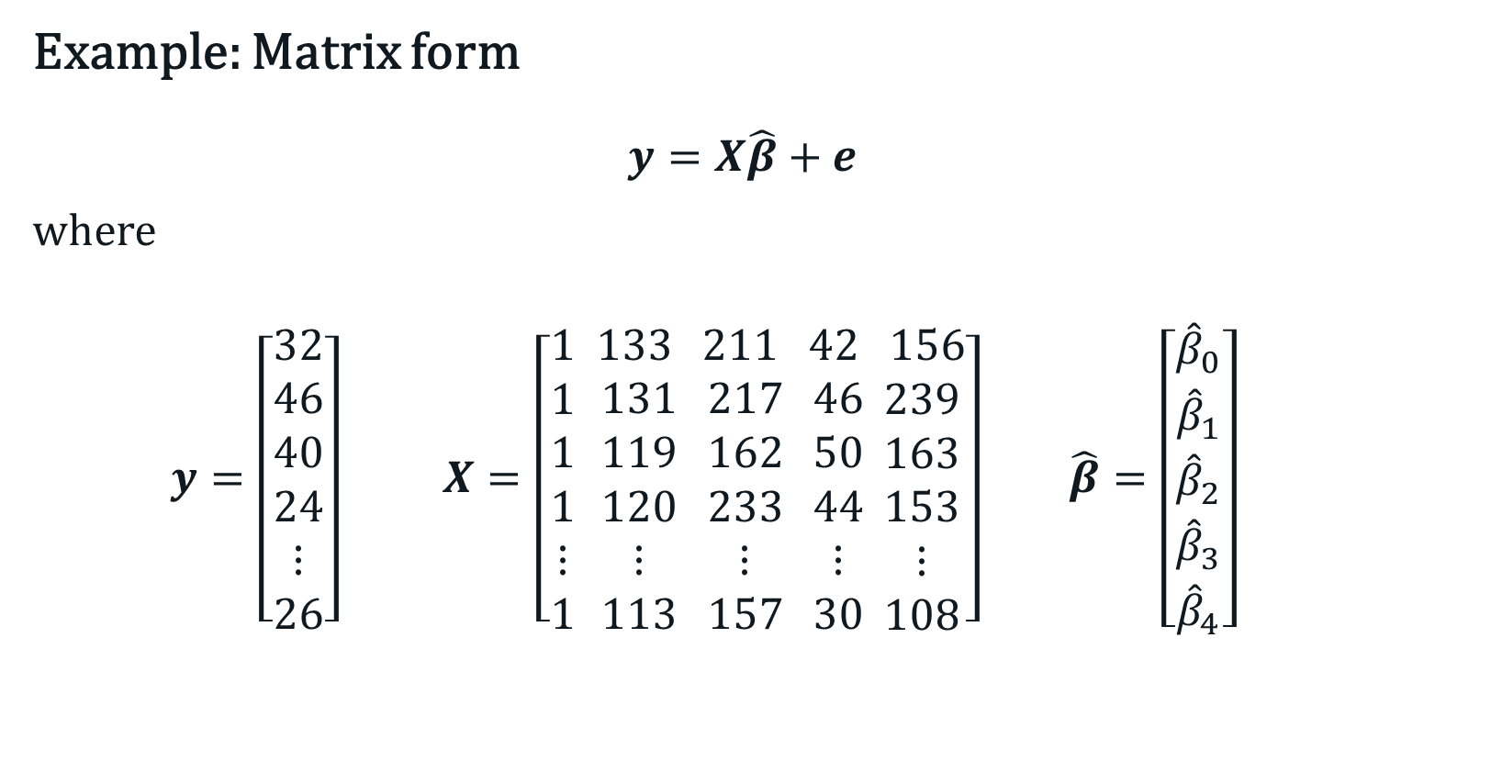
Linear Regression
Example: Matrix form
$$y=X\hat{β}+e$$
where
$y=\left[\begin{aligned}32 \\ 46 \\ 40 \\ 24 \\ ⋮ \\ 26\end{aligned}\right]$ $X=\left[\begin{aligned}1 \\ 1 \\ 1 \\ 1 \\ ⋮ \\ 1 \end{aligned}\begin{aligned} 133 \\ 131 \\ 119 \\ 120 \\ ⋮ \\ 113\end{aligned}\begin{aligned} 211 \\ 217 \\ 162 \\ 233 \\ ⋮ \\ 157\end{aligned}\begin{aligned} 42 \\ 46 \\ 50 \\ 44 \\ ⋮ \\ 30\end{aligned}\begin{aligned} 156 \\ 239 \\ 163 \\ 153 \\ ⋮ \\ 108\end{aligned}\right] \hat{β}=\left[\begin{aligned}{\hat{β}}_{0} \\ {\hat{β}}_{1} \\ {\hat{β}}_{2} \\ {\hat{β}}_{3} \\ {\hat{β}}_{4}\end{aligned}\right]$
Notes:
Cluster analysis is an “unsupervised” technique and makes no assumptions regarding the number of groups or the group structure.

Slide 8
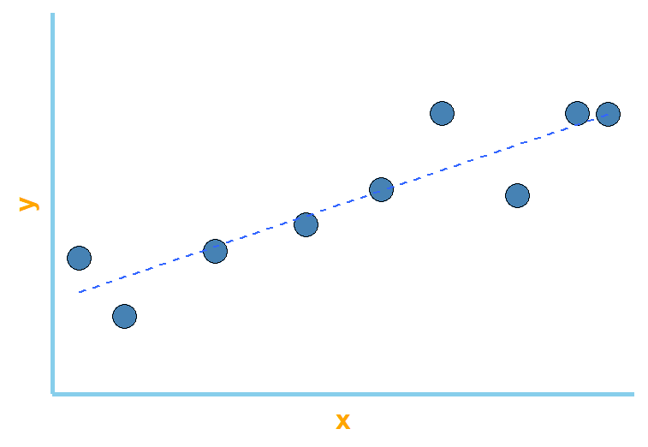
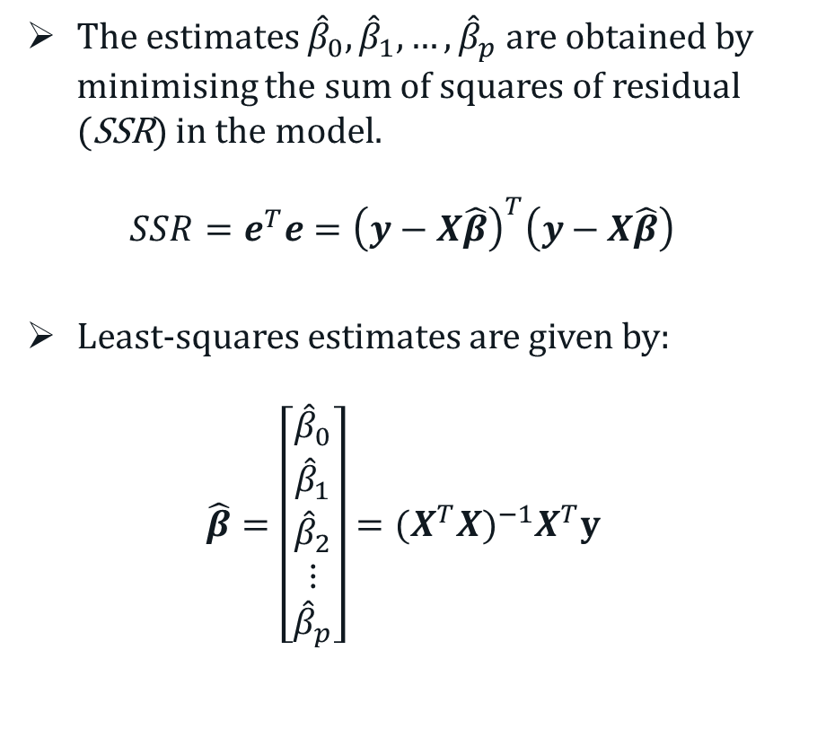
Linear Regression
The estimates ${\hat{β}}_{0}, {\hat{β}}_{1}, …,{\hat{β}}_{p}$ are obtained by minimising the sum of squares of residual (SSR) in the model.
$$SSR=e^{T}e={\left(y−X\hat{β}\right)}^{T}\left(y−X\hat{β}\right)$$
Least-squares estimates are given by:
$$\hat{β}=\left[\begin{aligned}{\hat{β}}_{0} \\ {\hat{β}}_{1} \\ {\hat{β}}_{2} \\ ⋮ \\ {\hat{β}}_{p}\end{aligned}\right]={(X^{T}X)}^{−1}X^{T}y$$
e₆
e₇
e₂
Notes:
Cluster analysis is an “unsupervised” technique and makes no assumptions regarding the number of groups or the group structure.

Slide 9
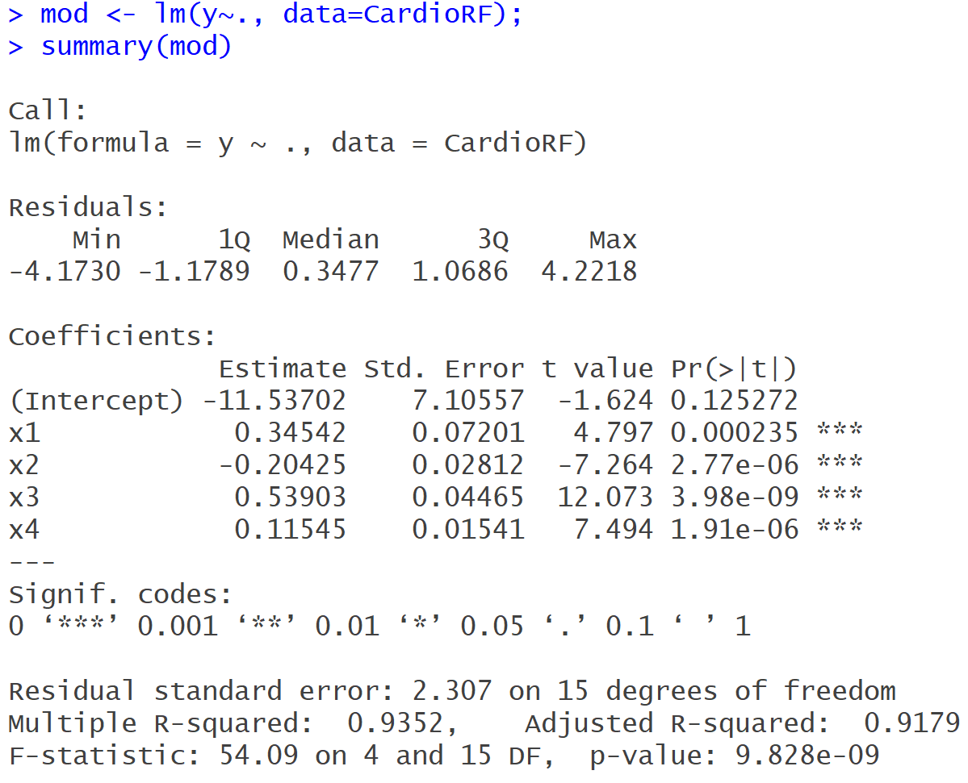
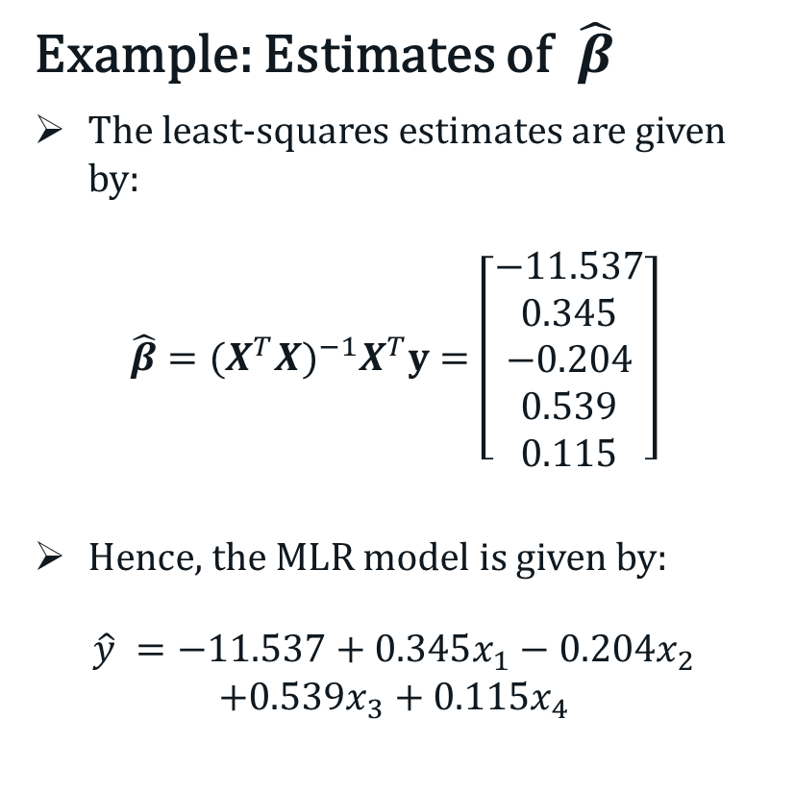
Linear Regression
Example: Estimates of $\hat{β}$
The least-squares estimates are given by:
$${\hat{β}=(X^{T}X)}^{−1}X^{T}y=\left[\begin{matrix}−11.537 \\ 0.345 \\ −0.204 \\ 0.539 \\ 0.115\end{matrix}\right]$$
Hence, the MLR model is given by:
$$\hat{y} =−11.537+0.345x_{1}−0.204x_{2}$$
$$+0.539x_{3}+0.115x_{4}$$
Notes:
Cluster analysis is an “unsupervised” technique and makes no assumptions regarding the number of groups or the group structure.

Slide 10
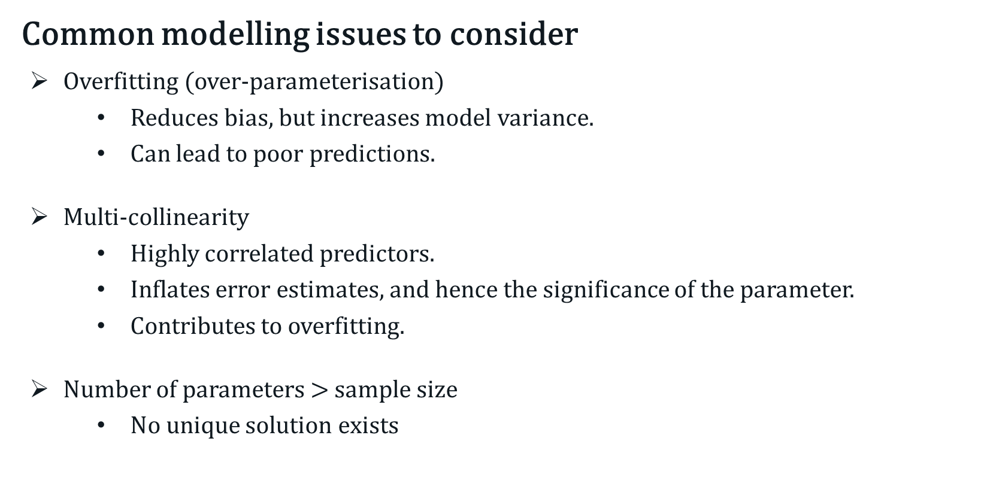
Linear Regression
Common modelling issues to consider
Overfitting (over-parameterisation)
Reduces bias, but increases model variance.
Can lead to poor predictions.
Multi-collinearity
Highly correlated predictors.
Inflates error estimates, and hence the significance of the parameter.
Contributes to overfitting.
Number of parameters $>$ sample size
No unique solution exists
Notes:
Cluster analysis is an “unsupervised” technique and makes no assumptions regarding the number of groups or the group structure.

Slide 11
Penalised Linear Regression
Three types of penalised regression models
Ridge regression
Least Absolute Shrinkage and Selection Operator (LASSO) regression
Elastic-net regression
Also known as “shrinkage” or “regularisation” methods.
Notes:
Cluster analysis is an “unsupervised” technique and makes no assumptions regarding the number of groups or the group structure.

Slide 12
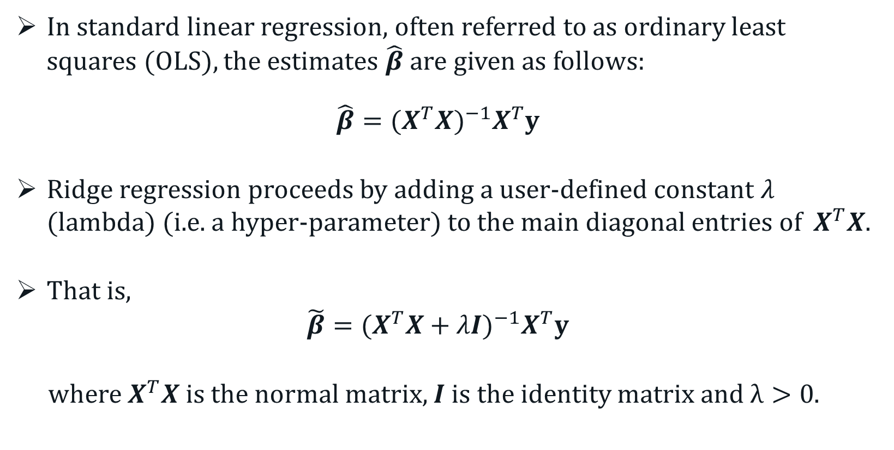
Ridge Regression
In standard linear regression, often referred to as ordinary least squares (OLS), the estimates $\hat{β}$ are given as follows:
$${\hat{β}=(X^{T}X)}^{−1}X^{T}y$$
Ridge regression proceeds by adding a user-defined constant $λ$ (lambda) (i.e. a hyper-parameter) to the main diagonal entries of $X^{T}X$.
That is,
$$\tilde{β}={(X^{T}X+λI)}^{−1}X^{T}y$$
where $X^{T}X$ is the normal matrix, $I$ is the identity matrix and $λ>0$.
Notes:
Cluster analysis is an “unsupervised” technique and makes no assumptions regarding the number of groups or the group structure.

Slide 13
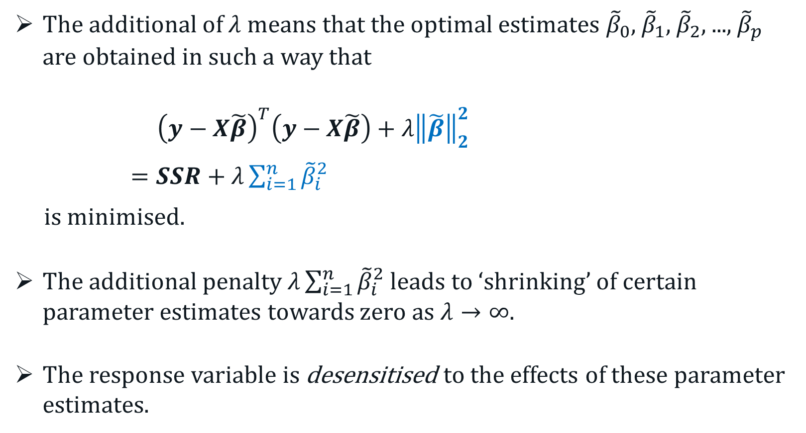
Ridge Regression
The additional of $λ$ means that the optimal estimates ${\tilde{β}}_{0}$, ${\tilde{β}}_{1}$, ${\tilde{β}}_{2}$, ..., ${\tilde{β}}_{p}$ are obtained in such a way that
${\left(y−X\tilde{β}\right)}^{T}\left(y−X\tilde{β}\right)+λ{\left\|\tilde{β}\right\|}_{2}^{2}$
$=SSR+λ\sum_{i=1}^{n}{{\tilde{β}}_{i}^{2}}$
is minimised.
The additional penalty $λ\sum_{i=1}^{n}{{\tilde{β}}_{i}^{2}}$ leads to ‘shrinking’ of certain parameter estimates towards zero as $λ→∞$.
The response variable is desensitised to the effects of these parameter estimates.
Notes:
Cluster analysis is an “unsupervised” technique and makes no assumptions regarding the number of groups or the group structure.

Slide 14
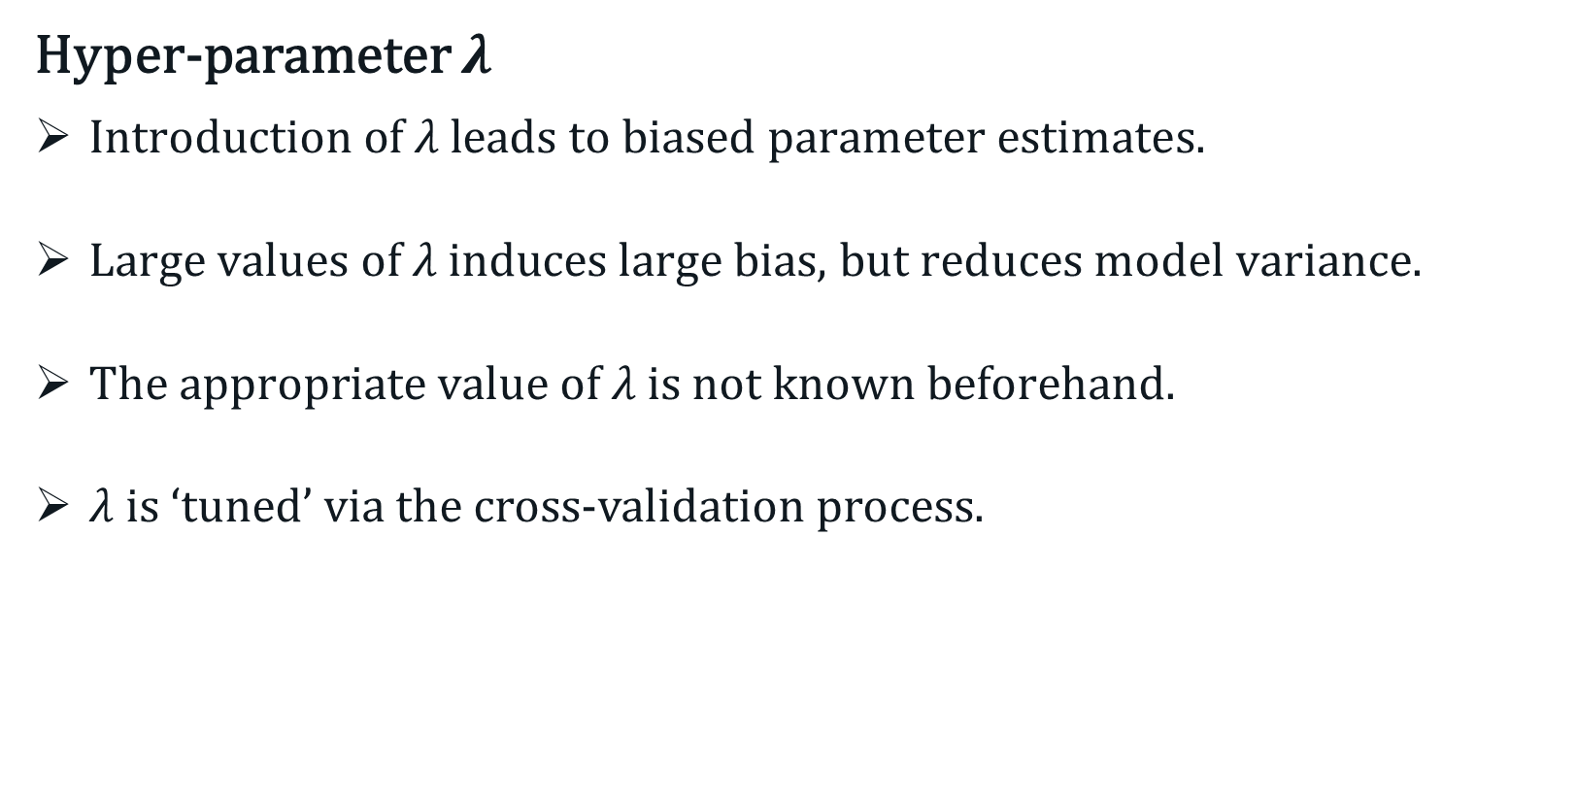
Ridge Regression
Hyper-parameter $λ$
$\text{Introduction} \text{of} λ \text{leads} \text{to} \text{biased} \text{parameter} \text{estimates}\text{.}$
$\text{Large} \text{values} \text{of} λ \text{induces} \text{large} \text{bias}\text{, }\text{but} \text{reduces} \text{model} \text{variance}\text{.}$
$\text{The} \text{appropriate} \text{value} \text{of} λ \text{is} \text{not} \text{known} \text{beforehand}\text{.}$
$λ$ is ‘tuned’ via the cross-validation process.
Notes:
Cluster analysis is an “unsupervised” technique and makes no assumptions regarding the number of groups or the group structure.

Slide 15
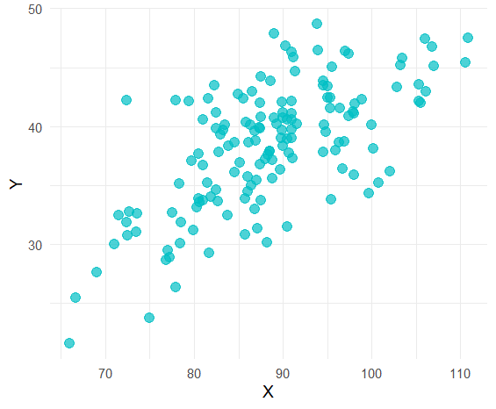

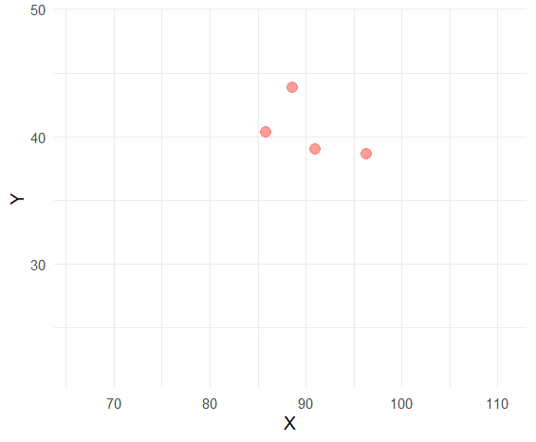
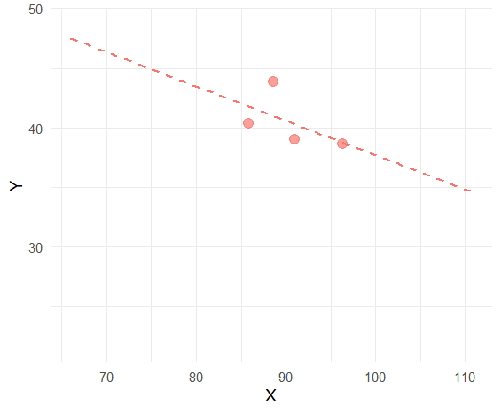
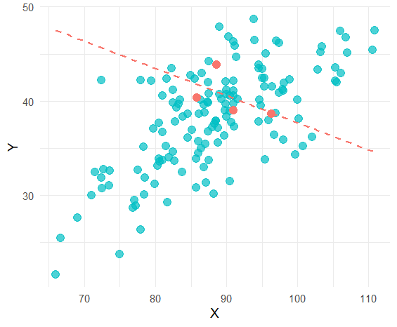
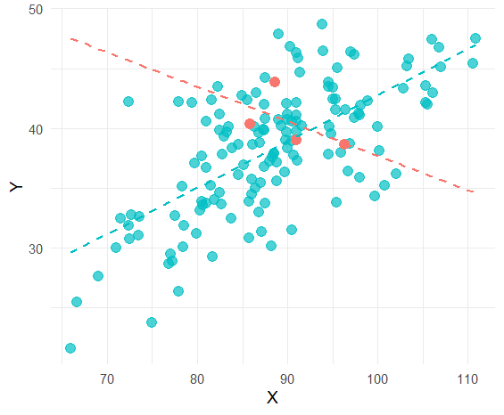




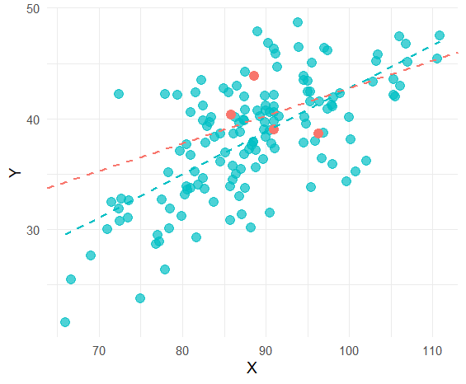

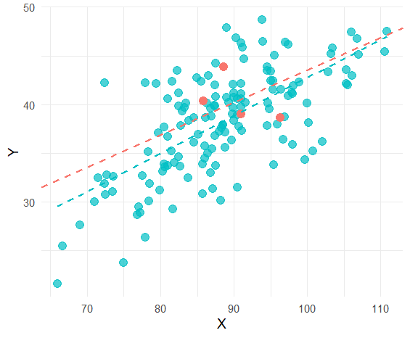
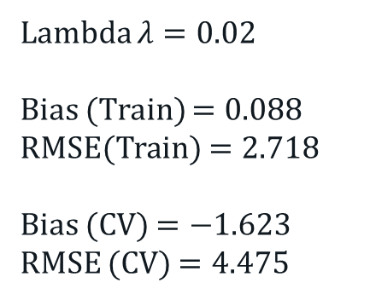
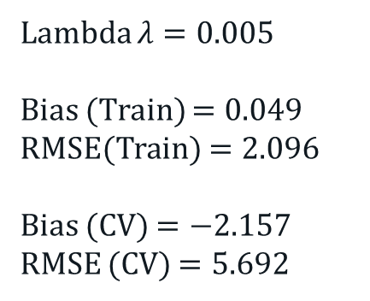
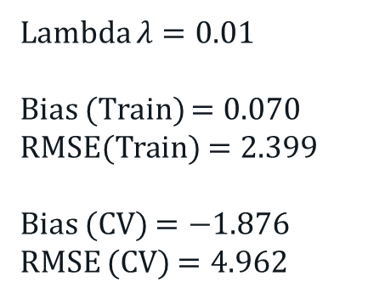
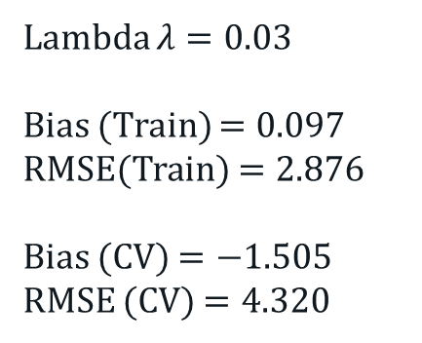
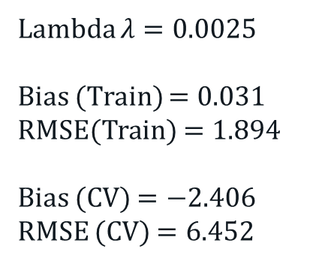
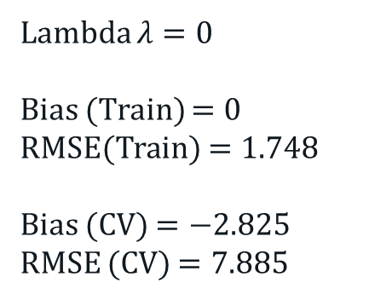
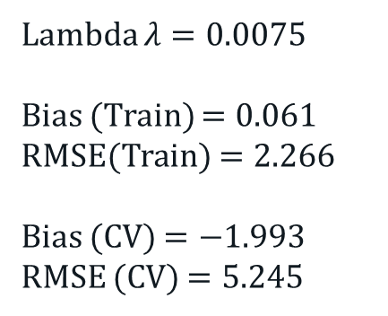
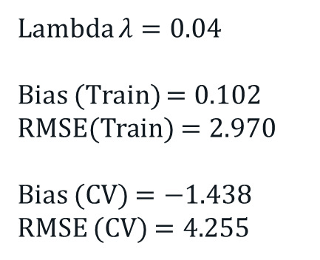
Ridge Regression
Graphical Illustration
Lambda $λ=0$
Bias (Train) $=0$
RMSE(Train) $=1.748$
Bias (CV) $=−2.825$
RMSE (CV) $=7.885$
Lambda $λ=0.0025$
Bias (Train) $=0.031$
RMSE(Train) $=1.894$
Bias (CV) $=−2.406$
RMSE (CV) $=6.452$
Lambda $λ=0.005$
Bias (Train) $=0.049$
RMSE(Train) $=2.096$
Bias (CV) $=−2.157$
RMSE (CV) $=5.692$
Lambda $λ=0.0075$
Bias (Train) $=0.061$
RMSE(Train) $=2.266$
Bias (CV) $=−1.993$
RMSE (CV) $=5.245$
Lambda $λ=0.01$
Bias (Train) $=0.070$
RMSE(Train) $=2.399$
Bias (CV) $=−1.876$
RMSE (CV) $=4.962$
Lambda $λ=0.0$2
Bias (Train) $=0.088$
RMSE(Train) $=2.718$
Bias (CV) $=−1.623$
RMSE (CV) $=4.475$
Lambda $λ=0.03$
Bias (Train) $=0.097$
RMSE(Train) $=2.876$
Bias (CV) $=−1.505$
RMSE (CV) $=4.320$
Lambda $λ=0.04$
Bias (Train) $=0.102$
RMSE(Train) $=2.970$
Bias (CV) $=−1.438$
RMSE (CV) $=4.$255
Notes:
Cluster analysis is an “unsupervised” technique and makes no assumptions regarding the number of groups or the group structure.

Slide 16
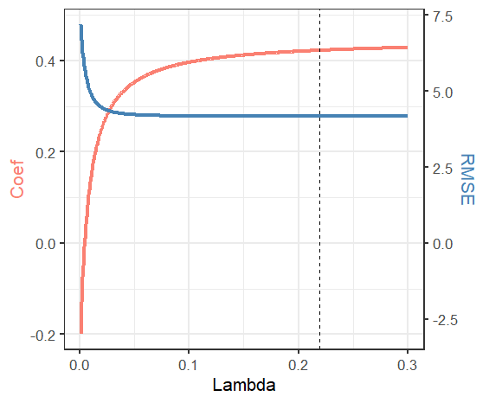
Ridge Regression
Lambda vs RMSE
Notes:
Cluster analysis is an “unsupervised” technique and makes no assumptions regarding the number of groups or the group structure.

Slide 17

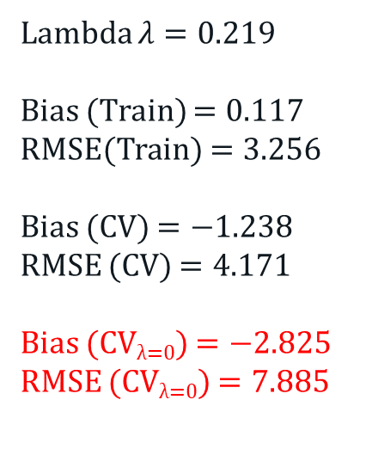
Ridge Regression
Optimal Solution
Lambda $λ=0$
Bias (Train) $=0$
RMSE(Train) $=1.748$
Bias (CV) $=−2.825$
RMSE (CV) $=7.885$
Lambda $λ=0.219$
Bias (Train) $=0.117$
RMSE(Train) $=3.256$
Bias (CV) $=−1.238$
RMSE (CV) $=4.171$
Bias (CV_{λ=0}) $=−2.825$
RMSE (CV_{λ=0}) $=7.885$
Notes:
Cluster analysis is an “unsupervised” technique and makes no assumptions regarding the number of groups or the group structure.

Slide 18
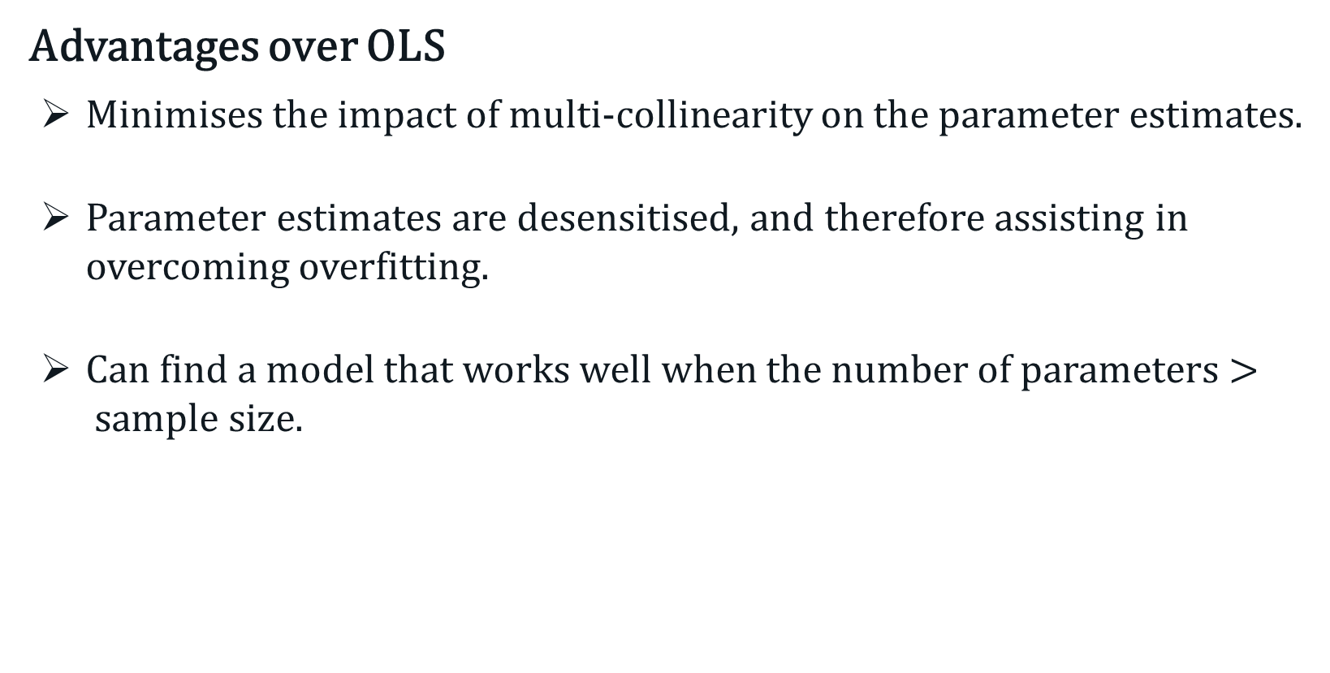
Ridge Regression
Advantages over OLS
Minimises the impact of multi-collinearity on the parameter estimates.
Parameter estimates are desensitised, and therefore assisting in overcoming overfitting.
Can find a model that works well when the number of parameters $>$sample size.
Notes:
Cluster analysis is an “unsupervised” technique and makes no assumptions regarding the number of groups or the group structure.

Slide 19
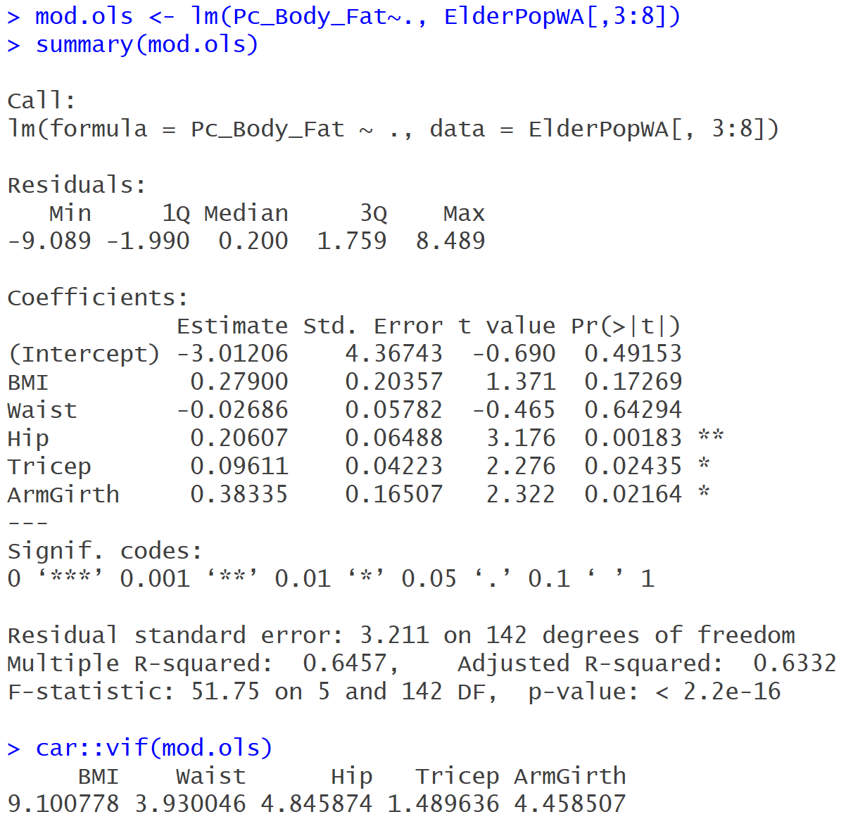
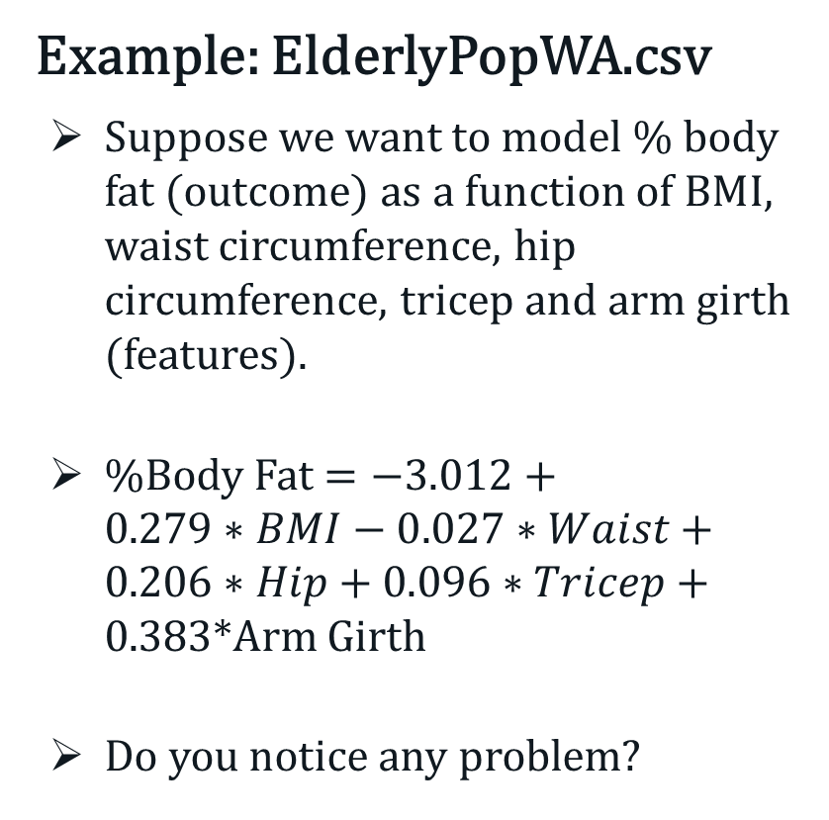
Ridge Regression
Example: ElderlyPopWA.csv
Suppose we want to model % body fat (outcome) as a function of BMI, waist circumference, hip circumference, tricep and arm girth (features).
%Body Fat $=−3.012+$ $0.279∗BMI−0.027∗Waist+0.206∗Hip+0.096∗Tricep+0.383$*Arm Girth
Do you notice any problem?
Notes:
Cluster analysis is an “unsupervised” technique and makes no assumptions regarding the number of groups or the group structure.

Slide 20
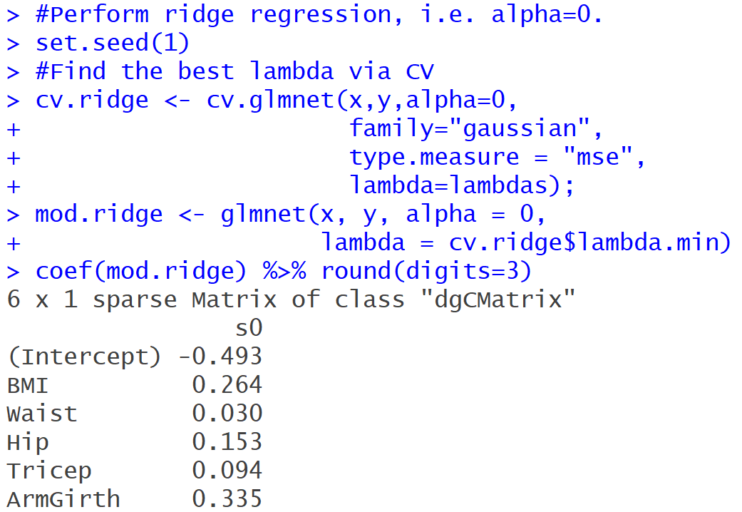
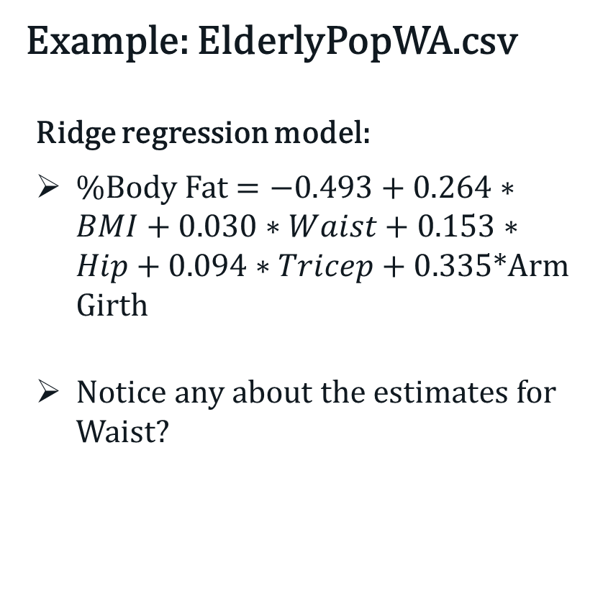
Ridge Regression
Example: ElderlyPopWA.csv
Ridge regression model:
%Body Fat $=−0.493+0.264∗BMI+0.030∗Waist+0.153∗Hip+0.094∗Tricep+0.335$*Arm Girth
Notice any about the estimates for Waist?
Notes:
Cluster analysis is an “unsupervised” technique and makes no assumptions regarding the number of groups or the group structure.

Slide 21
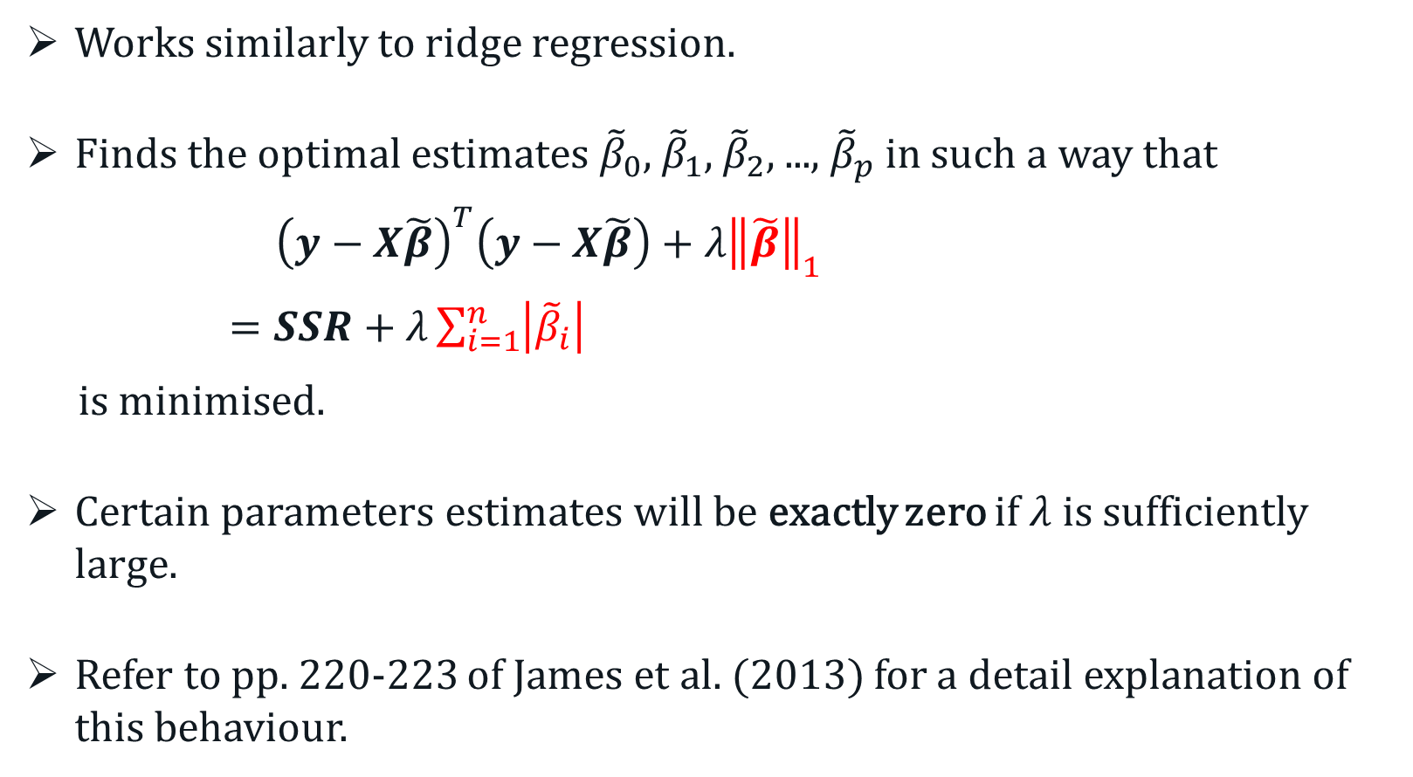
LASSO Regression
Works similarly to ridge regression.
Finds the optimal estimates ${\tilde{β}}_{0}$, ${\tilde{β}}_{1}$, ${\tilde{β}}_{2}$, ..., ${\tilde{β}}_{p}$ in such a way that
${\left(y−X\tilde{β}\right)}^{T}\left(y−X\tilde{β}\right)+λ{\left\|\tilde{β}\right\|}_{1}$
$=SSR+λ\sum_{i=1}^{n}{\left|{\tilde{β}}_{i}\right|}$
is minimised.
Certain parameters estimates will be exactly zero if $λ$ is sufficiently large.
Refer to pp. 220-223 of James et al. (2013) for a detail explanation of this behaviour.
Notes:
Cluster analysis is an “unsupervised” technique and makes no assumptions regarding the number of groups or the group structure.

Slide 22
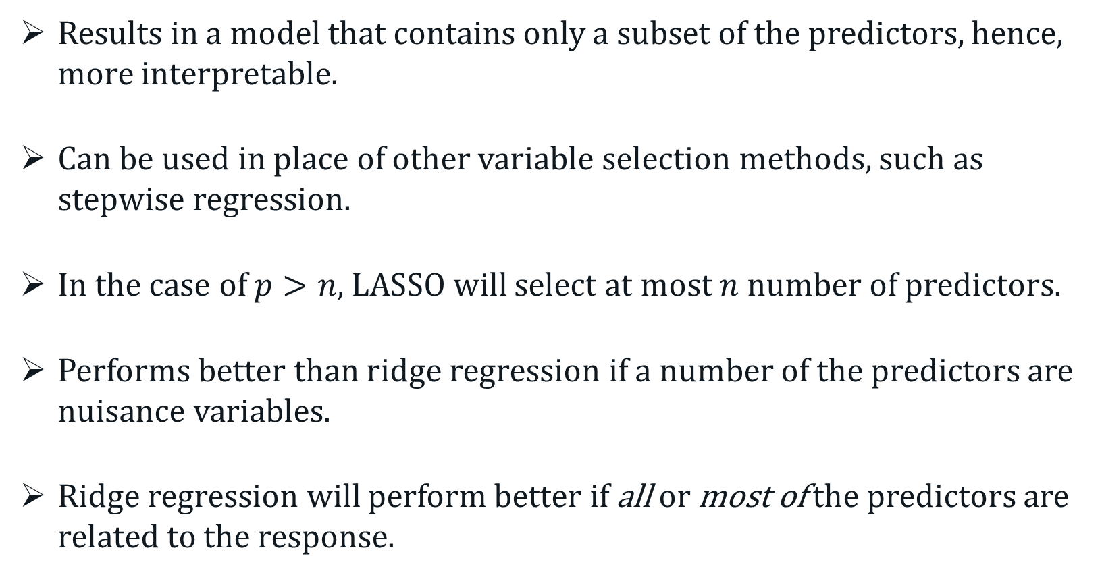
LASSO Regression
Results in a model that contains only a subset of the predictors, hence, more interpretable.
Can be used in place of other variable selection methods, such as stepwise regression.
In the case of $p>n$, LASSO will select at most $n$ number of predictors.
Performs better than ridge regression if a number of the predictors are nuisance variables.
Ridge regression will perform better if all or most of the predictors are related to the response.
Notes:
Cluster analysis is an “unsupervised” technique and makes no assumptions regarding the number of groups or the group structure.

Slide 23
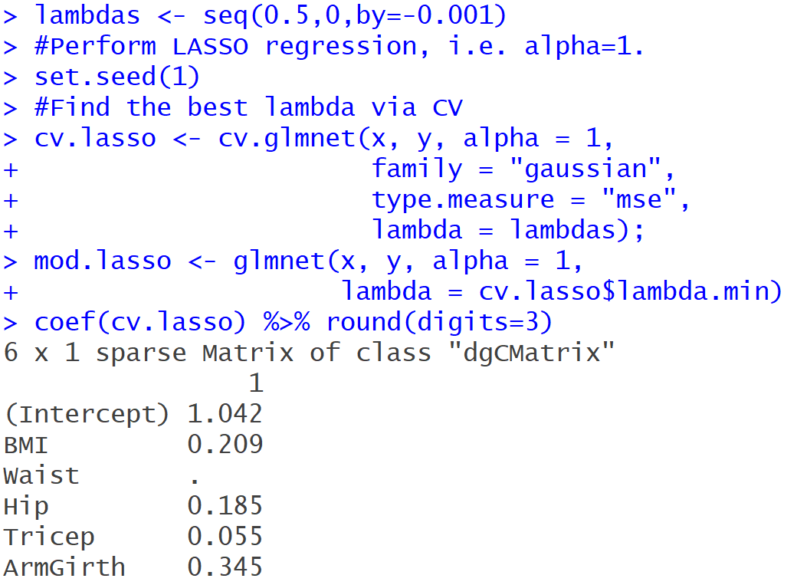
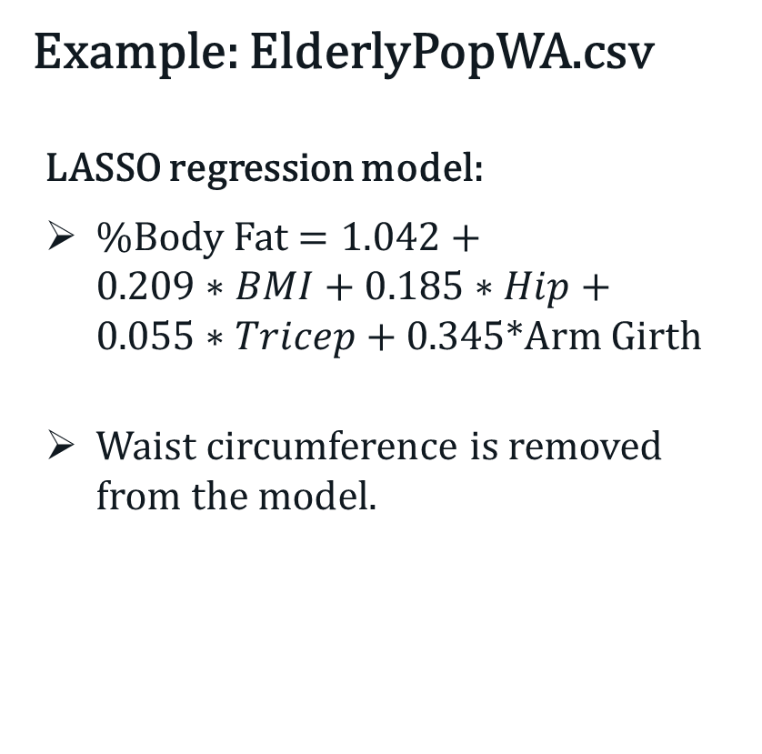
Ridge Regression
Example: ElderlyPopWA.csv
LASSO regression model:
%Body Fat $=1.042+$ $0.209∗BMI+0.185∗Hip+0.055∗Tricep+0.345$*Arm Girth
Waist circumference is removed from the model.
Notes:
Cluster analysis is an “unsupervised” technique and makes no assumptions regarding the number of groups or the group structure.

Slide 24
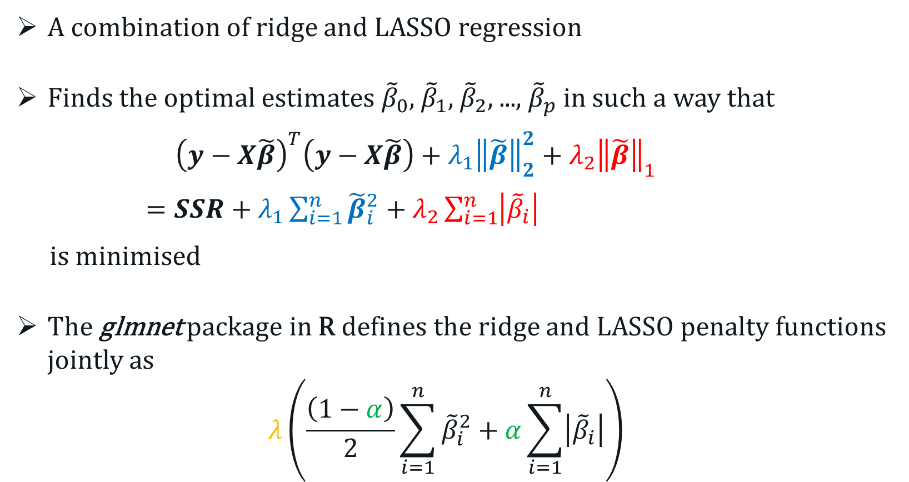
Elastic-Net Regression
A combination of ridge and LASSO regression
Finds the optimal estimates ${\tilde{β}}_{0}$, ${\tilde{β}}_{1}$, ${\tilde{β}}_{2}$, ..., ${\tilde{β}}_{p}$ in such a way that
${\left(y−X\tilde{β}\right)}^{T}\left(y−X\tilde{β}\right)+λ_{1}{\left\|\tilde{β}\right\|}_{2}^{2}+λ_{2}{\left\|\tilde{β}\right\|}_{1}$
$=SSR+λ_{1}\sum_{i=1}^{n}{{\tilde{β}}_{i}^{2}}+λ_{2}\sum_{i=1}^{n}{\left|{\tilde{β}}_{i}\right|}$
is minimised
The glmnet package in R defines the ridge and LASSO penalty functions jointly as
$$λ\left(\frac{\left(1−α\right)}{2}\sum_{i=1}^{n}{{\tilde{β}}_{i}^{2}}+α\sum_{i=1}^{n}{\left|{\tilde{β}}_{i}\right|}\right)$$
Notes:
Cluster analysis is an “unsupervised” technique and makes no assumptions regarding the number of groups or the group structure.

Slide 25
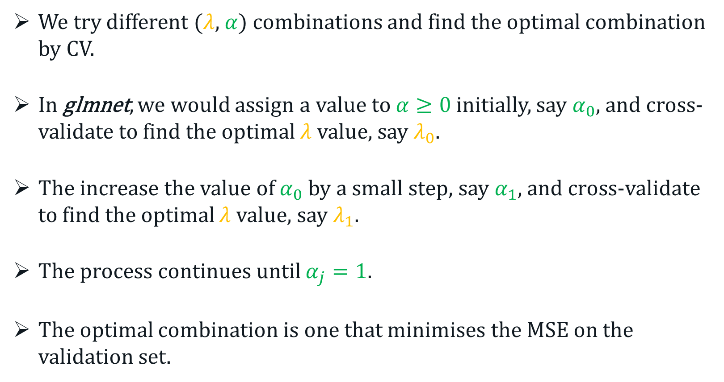
Elastic-Net Regression
We try different ($λ$, $α$) combinations and find the optimal combination by CV.
In glmnet, we would assign a value to $α≥0$ initially, say $α_{0}$, and cross-validate to find the optimal $λ$ value, say $λ_{0}$.
The increase the value of $α_{0}$ by a small step, say $α_{1}$, and cross-validate to find the optimal $λ$ value, say $λ_{1}$.
The process continues until $α_{j}=1$.
The optimal combination is one that minimises the MSE on the validation set.
Notes:
Cluster analysis is an “unsupervised” technique and makes no assumptions regarding the number of groups or the group structure.

Slide 26
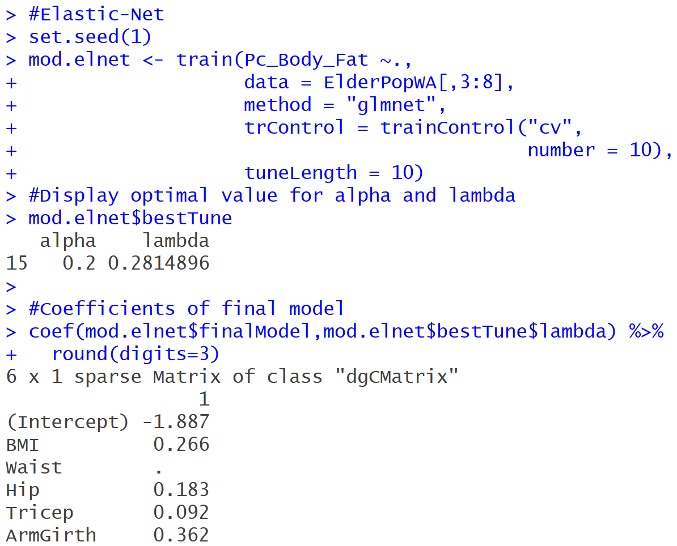
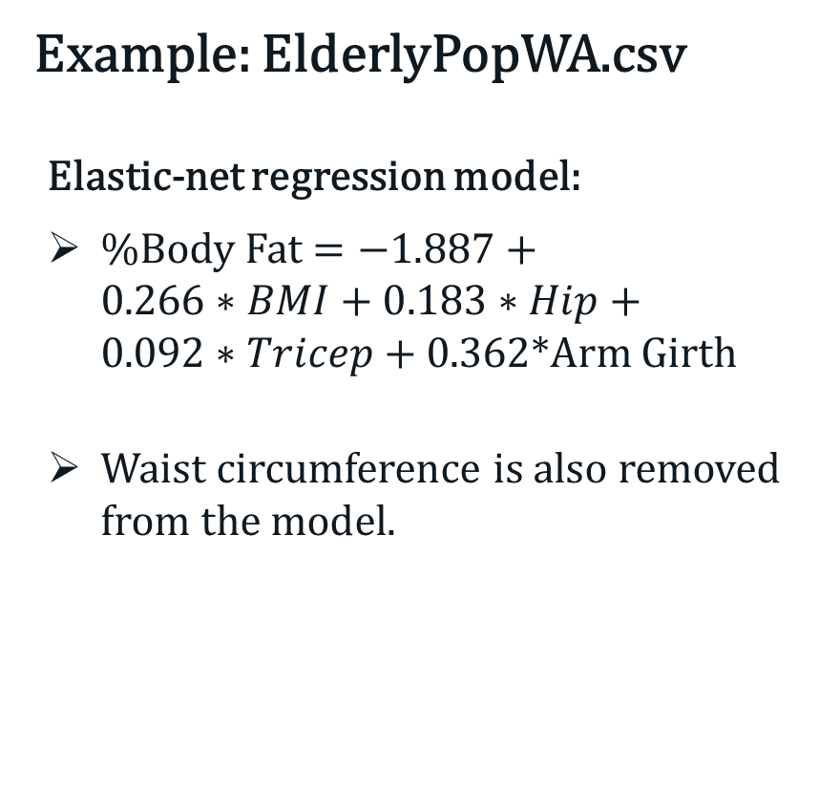
Elastic-Net Regression
Example: ElderlyPopWA.csv
Elastic-net regression model:
%Body Fat $=−1.887+$ $0.266∗BMI+0.183∗Hip+0.092∗Tricep+0.362$*Arm Girth
Waist circumference is also removed from the model.
Notes:
Cluster analysis is an “unsupervised” technique and makes no assumptions regarding the number of groups or the group structure.

